Slide 1

Presents
Docker

Slide 2
Agenda (Summarized)
1. Installing the Docker Engine 2. Creating our first Docker container 3. Building Docker images 4. Storing and retrieving Docker images from Docker Hub 5. Building containers from images 6. Deploying applications with Docker 7. Networking Docker containers 8. Data persistence with Volumes 9. Using Docker into a Continuous Integration and Deployment process

Slide 3

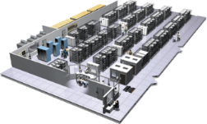
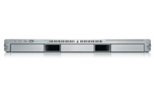
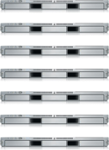
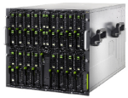

The Challenge
User DB
Static website
postgresql + pgv8 + v8
Queue
Analytics DB
nginx 1.5 + modsecurity + openssl + bootstrap 2
Do services and apps interact appropriately?
Multiplicity of Stacks
Redis + redis-sentinel
hadoop + hive + thrift + OpenJDK
Background workers
Web frontend
Python 3.0 + celery + pyredis + libcurl + ffmpeg + libopencv + nodejs + phantomjs
Ruby + Rails + sass + Unicorn
API endpoint
Python 2.7 + Flask + pyredis + celery + psycopg + postgresql-client
Development VM
Production Cluster
Multiplicity of hardware environments
Public Cloud
QA server
Can I migrate smoothly and quickly?
Disaster recovery
Customer Data Center
Contributor’s laptop
Production Servers

Slide 4
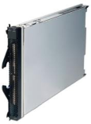

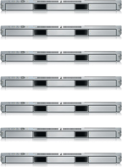
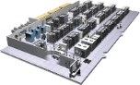

The Matrix From Hell
? | ? | ? | ? | ? | ? | ?
? | ? | ? | ? | ? | ? | ?
? | ? | ? | ? | ? | ? | ?
? | ? | ? | ? | ? | ? | ?
? | ? | ? | ? | ? | ? | ?
? | ? | ? | ? | ? | ? | ?
Static website
Web frontend
Background workers
User DB
Analytics DB
Queue
 | Development VM | QA Server | Single Prod Server | Onsite Cluster | Public Cloud | Contributor’s laptop | Customer Servers

Slide 5
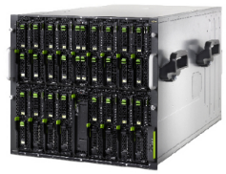
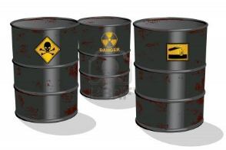
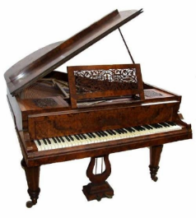
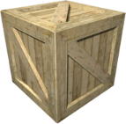
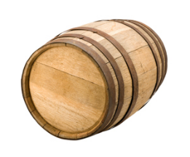
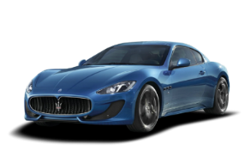
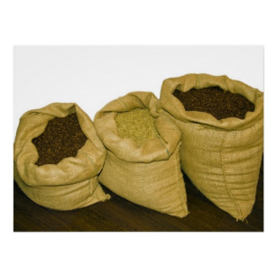



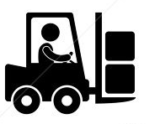
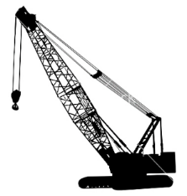
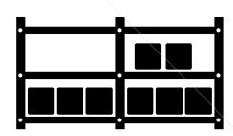

Cargo Transport Pre-1960
Do I worry about how goods interact (e.g. coffee beans next to spices)
Multiplicity of Goods
Multipilicity of methods for transporting/storing
Can I transport quickly and smoothly
(e.g. from boat to train to truck)

Slide 6


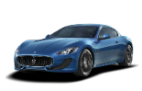


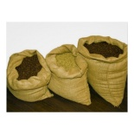







Also a matrix from hell
 | ? | ? | ? | ? | ? | ? | ?
 | ? | ? | ? | ? | ? | ? | ?
 | ? | ? | ? | ? | ? | ? | ?
 | ? | ? | ? | ? | ? | ? | ?
 | ? | ? | ? | ? | ? | ? | ?
 | ? | ? | ? | ? | ? | ? | ?

Slide 7


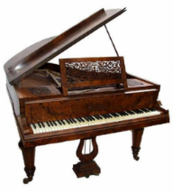
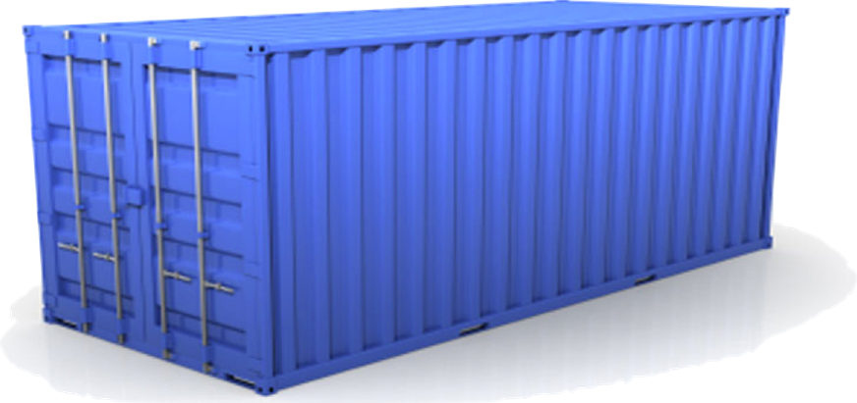
Solution: Intermodal Shipping Container
Do I worry about how goods interact (e.g. coffee beans next to spices)
Multiplicity of Goods
A standard container that is loaded with virtually any goods, and stays sealed until it reaches final delivery.
…in between, can be loaded and unloaded, stacked, transported efficiently over long distances, and transferred from one mode of transport to another
Multiplicity of methods for transporting/storing
Can I transport quickly and smoothly
(e.g. from boat to train to truck)

Slide 8
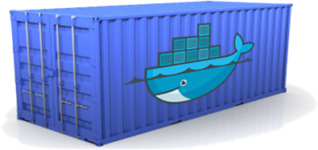
Docker is a shipping container system for code
Static website
User DB
Web frontend
Queue
Analytics DB
Do services and apps interact appropriately?
Multiplicity of Stacks
An engine that enables any payload to be encapsulated as a lightweight, portable, self-sufficient container…
…that can be manipulated using standard operations and run consistently on virtually any hardware platform
Multiplicity of hardware environments
Can I migrate smoothly and quickly
Development VM
QA server
Customer Data Center
Public Cloud
Production Cluster
Contributor’s laptop

Slide 9
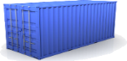
Docker eliminates the matrix from Hell
Static website
Web frontend
Background workers
User DB
Analytics DB
Queue
 | Development VM | QA Server | Single Prod Server | Onsite Cluster | Public Cloud | Contributor’s laptop | Customer Servers

Slide 10
Why Developers Care
Build once…(finally) run anywhere*
A clean, safe, hygienic and portable runtime environment for your app.
No worries about missing dependencies, packages and other pain points during subsequent deployments.
Run each app in its own isolated container, so you can run various versions of libraries and other dependencies for each app without worrying
Automate testing, integration, packaging…anything you can script
Reduce/eliminate concerns about compatibility on different platforms, either your own or your customers.
Cheap, zero-penalty containers to deploy services? A VM without the overhead of a VM? Instant replay and reset of image snapshots? That’s the power of Docker
* With the 0.7 release, we support any x86 server running a modern Linux kernel (3.2+ generally. 2.6.32+ for RHEL 6.5+, Fedora, & related)

Slide 11
Why Devops Cares?
Configure once…run anything
Make the entire lifecycle more efficient, consistent, and repeatable
Increase the quality of code produced by developers.
Eliminate inconsistencies between development, test, production, and customer environments
Support segregation of duties
Significantly improves the speed and reliability of continuous deployment and continuous integration systems
Because the containers are so lightweight, address significant performance, costs, deployment, and portability issues normally associated with VMs

Slide 12
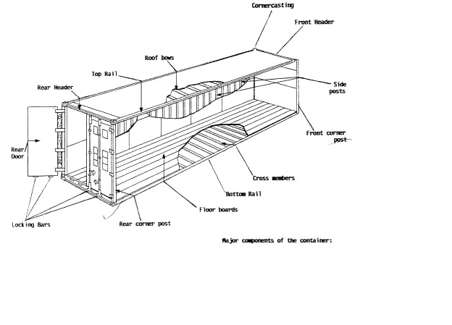
Why it works—separation of concerns
Dan the Developer
Worries about what’s “inside” the container
His code
His Libraries
His Package Manager
His Apps
His Data
All Linux servers look the same
Oscar the Ops Guy
Worries about what’s “outside” the container
Logging
Remote access
Monitoring
Network config
All containers start, stop, copy, attach, migrate, etc. the same way

Slide 13
More technical explanation
WHY
WHAT
Run everywhere
Regardless of kernel version (2.6.32+)
Regardless of host distro
Physical or virtual, cloud or not
Container and host architecture must match*
Run anything
If it can run on the host, it can run in the container
i.e. if it can run on a Linux kernel, it can run
High Level—It’s a lightweight VM
Own process space
Own network interface
Can run stuff as root
Can have its own /sbin/init (different from host)
<<machine container>>
Low Level—It’s chroot on steroids
Can also not have its own /sbin/init
Container=isolated processes
Share kernel with host
No device emulation (neither HVM nor PV) from host)
<<application container>>

Slide 14
Containers vs. VMs
App
A
App
A’
App
B
Containers are isolated,
but share OS and, where
appropriate, bins/libraries
Bins/
Libs
Bins/
Libs
Bins/
Libs
VM
Guest
OS
Guest
OS
Guest
OS
…result is significantly faster deployment, much less overhead, easier migration, faster restart
Guest
OS
Guest
OS
App A
App A’
App B
App B’
App B’
App B’
Container
Docker
Hypervisor (Type 2)
Bins/Libs
Bins/Libs
Host OS
Host OS
Server
Server

Slide 15
Why are Docker containers lightweight?
VMs
Containers
App
A
App
A
App
A’
App
A
App
A
App Δ
Bins/
Libs
Bins/
Libs
Bins/
Libs
Bins/
Libs
Bins/
Guest
OS
Guest
OS
Guest
OS
Guest
OS
Original App
(No OS to take
up space, resources,
or require restart)
Copy of
App
No OS. Can
Share bins/libs
Modified App
Copy on write capabilities allow
us to only save the diffs
Between container A and container
A’
VMs
Every app, every copy of an
app, and every slight modification
of the app requires a new virtual server

Slide 16
What are the basics of the Docker system?
Container A
Docker
Container
Image Registry
Push
Search
Pull
Source Code Repository
Build
Run
Dockerfile
For
A
Container A
Container B
Container C
Docker
Docker Engine
Host 1 OS (Linux)
Host 2 OS (Linux)

Slide 17
Changes and Updates
Docker
Container
Image Registry
App
A
Push
App Δ
Bins/
Libs
Bins/
Base
Container
Image
Container Mod A’
Container Mod A’’
App Δ
Update
App
A’’
App
A
Bins/
Bins/
Libs
Bins/
Libs
Bins/
Docker Engine
Docker Engine
Host is now running A’’
Host running A wants to upgrade to A’’. Requests update. Gets only diffs

Slide 18

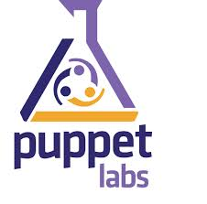
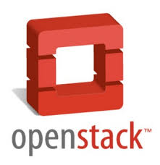






Ecosystem Support
Operating systems
Virtually any distribution with a 2.6.32+ kernel
Red Hat/Docker collaboration to make work across RHEL 6.4+, Fedora, and other members of the family (2.6.32 +)
CoreOS—Small core OS purpose built with Docker
OpenStack
Docker integration into NOVA (& compatibility with Glance, Horizon, etc.) accepted for Havana release
Private PaaS
OpenShift
Solum (Rackspace, OpenStack)
Other TBA
Public PaaS
Deis, Voxoz, Cocaine (Yandex), Baidu PaaS
Public IaaS
Native support in Rackspace, Digital Ocean,+++
AMI (or equivalent) available for AWS & other
DevOps Tools
Integrations with Chef, Puppet, Jenkins, Travis, Salt, Ansible +++
Orchestration tools
Mesos, Heat, ++
Shipyard & others purpose built for Docker
Applications
1000’s of Dockerized applications available at index.docker.io

Slide 19
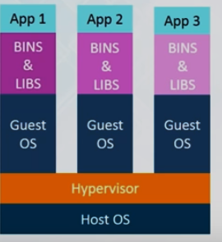
Virtualization
Notes:
Multiple OS on same machine
Easy Maintenance & Recovery
Lower Cost
Disadv : Unstable, Hypervisors not efficient as OS, Long Boot up Time ( 1 minute onwards)
Scaling is costly & tedious ; Resource Utilization n is nit god or anywhere.
A hypervisor is a function which abstracts -- isolates -- operating systems and applications from the underlying computer hardwar

Slide 20
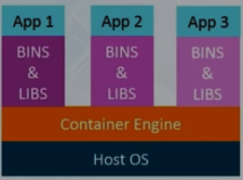
Docker
Notes:
Containers on same host OS Kernel
Better Resource Utilization & boot is fast.
People usex mix, Containerization on top of

Slide 21
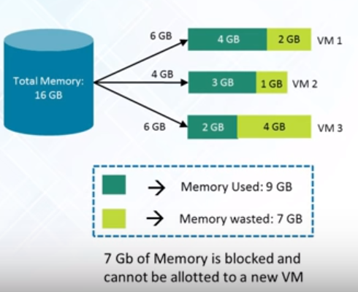
Virtualization – Space Used

Slide 22
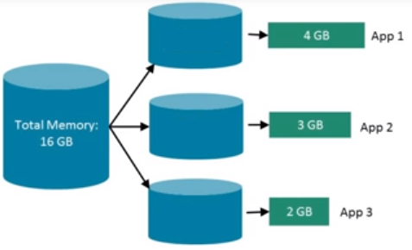
Docker –Space Used

Slide 23
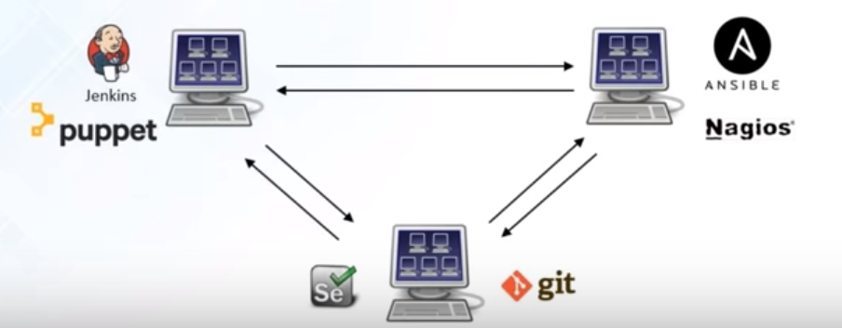
Virtualization - Integration
Notes:
Costly(due to infrastructure requirements) & not scalable

Slide 24
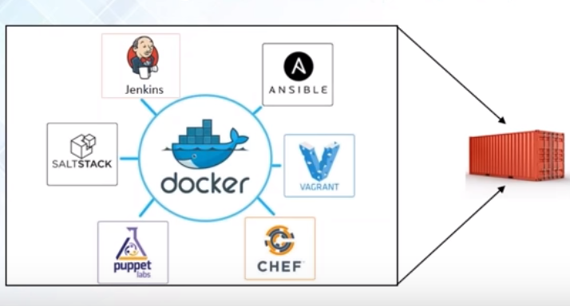
Docker - Integration

Slide 25
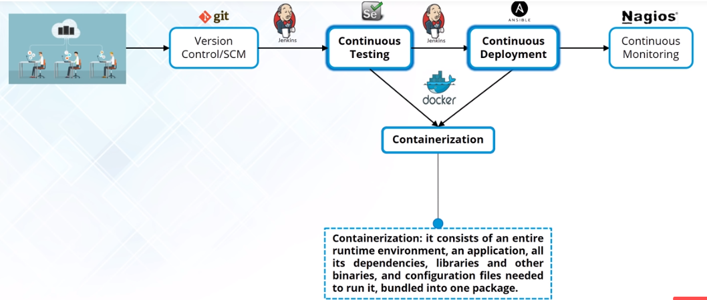
Docker & Devops

Slide 26
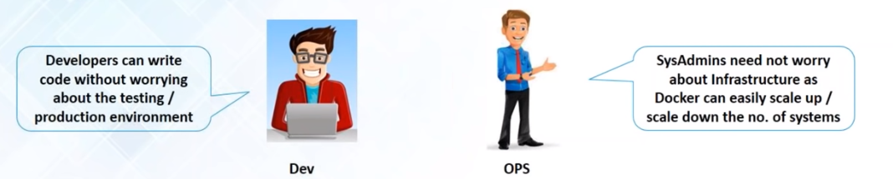
Docker for Everyone

Slide 27
Docker -Introduction
Docker
Open platform for developing, shipping, and running applications
Separation between application & Infrastructure
Manage your Infrastructure as if it is a application
Speed up the Dev to Prod Cycle
Easily clone the environment
Notes:
Run application in isolated environment called a container.
The isolation and security allow you to run many containers simultaneously on a given host.
Containers are lightweight because they don’t need the extra load of a hypervisor, but run directly within the host machine’s kernel.
Hence more multiple containers
Even in host those are virtual machines!
Docker – Containerization platform which packages appln & its dependencies together in form of Containers so app can work & n environment agnostic
Lifecycle Manager of Container:
Develop your application using Docker
Distribute & test application using Docker
Deployment is now Environment agnostic

Slide 28

Docker Engine
Notes:
Docker Engine consists of :
Daemon - dockerd
REST Api – Interfaces used by Programs to talk to Daemon & instructing it what to do.
Command line Interface (CLI) – Docker Command
CLI uses Rest API to send commands to daemon through script or direct CLI
Docker manages docker objects – images, containers, networks & Volumes

Slide 29
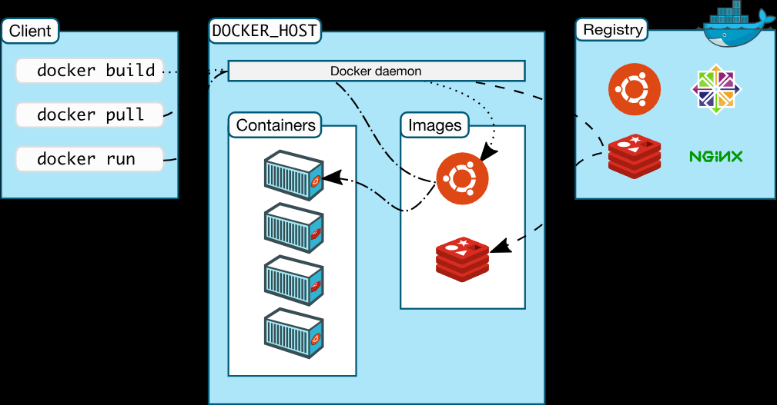
Docker – Architecture
Notes:
Client Server
Docker Client to Docker Daemon
Daemon - building, running, and distributing your Docker containers.
Same System for Docker Client & Daemon or Daemon on Diff Server
Communication between Docker Client & Daemon – Rest API , Unix Socket or network Interface

Slide 30
Docker Architeture
Docker
Docker Daemon
Docker Client
Docker Registries
Notes:
Daemon(dockerd)-> listens for Docker API requests
manages Docker objects such as images, containers, networks, and volumes
communicate with other daemons to manage Docker services
Docket Client(docker) -> You use this to send commands to daemon
Uses Docker API , can communicate to multiple Daemons
Docker Registry - > eg DockerHub , stores Docker images
You can even run your own private registry
Pull for download & Push for checkin

Slide 31
Features of Docker
Fast Delivery of applications
Portable
Lightweight & Fast
Cost Effective
Notes:
Fast Delivery – CI/CD
Ex : Share code with colleagues through docker – push app using Docker and test applications
Fix bugs in Dev , test in Test Envt
Getting fix to Customer is just pushing new Docker Image
local laptop, on physical or virtual machines in a data center, on cloud providers, or in a mixture of environments.
Cost-effective alternative to hypervisor-based virtual machines so that now you can use those resources for something else

Slide 32
Docker – The Technology Inside
Docker Technology
Written in Go
Uses Namespaces to provide isolated workspaces
E.g. PID
Control Groups
UninoFS( Union File Systems)
Container Format
Notes:
Eg of Workspaces : PID, net (network interfaces), ipc ( Interprocess communication), mnt ( file system mount point), uts(isolate kernel & version identifiers
Control Groups - Limit no of resources allocated to Applications
UnionFS – Provide Building Blocks for Containers
namespaces, control groups, and UnionFS to get Container Format

Slide 33
Docker Run – Life Cycle
Docker Run Command Life cycle :
Pull from registry
Creates a new Container
Allocates read-write file system to Container
Connect Container to default network or
Docker Container is started
Executes bin/bash

Slide 34
Why Docker?
Works on my localhost !
Productivity
Team Networking

Slide 35
Features of Docker?
Portable
Scalable
Flexible
Lightweight
Interchangeable
Stackable

Slide 36
Docker for Windows
Docker for Windows installs
Docker Engine
Docker Compose
Docker Machine
Kitematic

Slide 37
Docker
Docker Objects
Images
Containers
Services
Notes:
read-only template with instructions for creating a Docker container.
Often, an image is based on another image, with some additional customization.
For example, you may build an image which is based on the ubuntu image, but installs the Apache web server and your application, as well as the configuration details needed to make your application run.
Create or download from registry.
For creation – create a dockerfile , each statement is a command or instruction , creating a layer in image.
When rebuilding only changed part is rebuilt hence rebuild is also faster
Container – Runnable instance of Image
Scale containers across multiple daemons, Alllows you to define desired state ( how many service replicas)must be available
Service is load balanced so to docker client it looks like a single application.

Slide 38
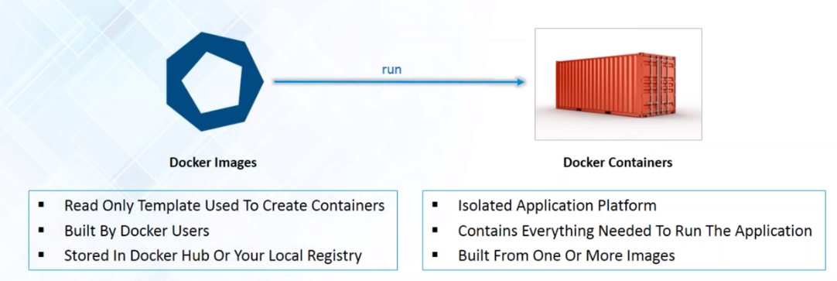
Docker Images & Container

Slide 39
Terminology - Image
Persisted snapshot that can be run
images: List all local images
run: Create a container from an image and execute a command in it
tag: Tag an image
pull: Download image from repository
rmi: Delete a local image
This will also remove intermediate images if no longer used

Slide 40
Terminology - Container
Runnable instance of an image
ps: List all running containers
ps –a: List all containers (incl. stopped)
top: Display processes of a container
start: Start a stopped container
stop: Stop a running container
pause: Pause all processes within a container
rm: Delete a container
commit: Create an image from a container
Notes:
docker run --rm to remove container after termination

Slide 41
Image vs. Container
Base Image
ubuntu:latest
run
Container
cid1
base image
cmd → new state
New Image
iid1
commit
Container
cid1
run
Container
cid2
Container
cid3
Container
cid4

Slide 42
Docker – Getting Started
Correct the Cursor Settings

Slide 43
Hands on
docker ps
docker --version
docker version
docker run hello-world
docker images ls
docker container ls --all

Slide 44
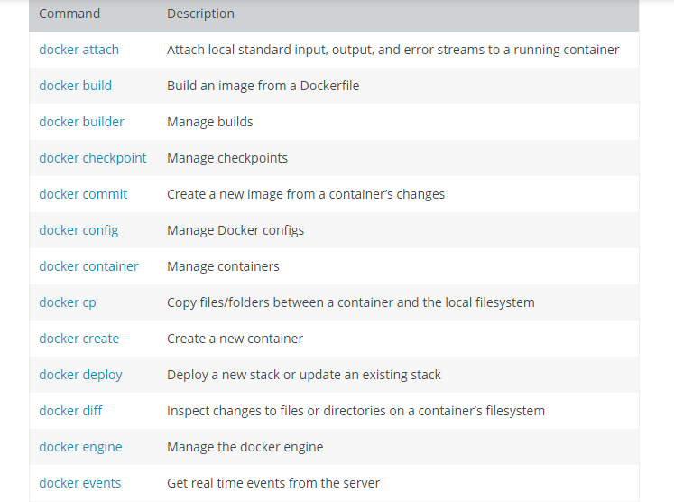
Docker Commands

Slide 45
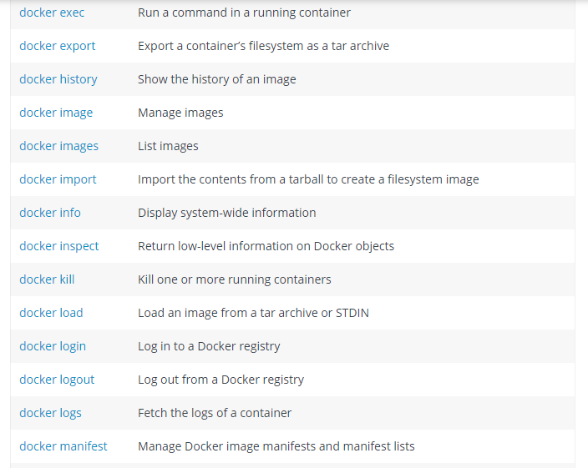

Slide 46
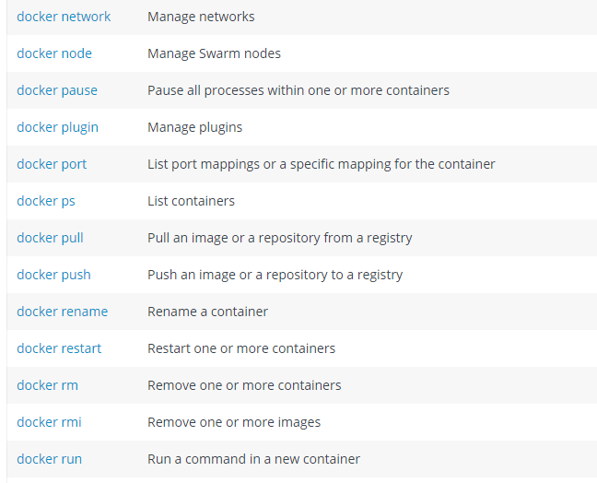
Docker Commands

Slide 47
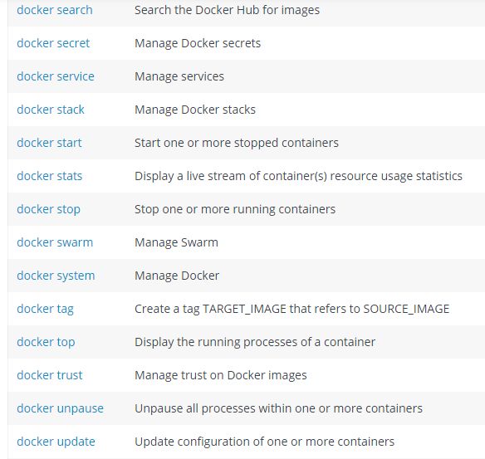
Docker Commands

Slide 48
Dockerfile Commands
The docker build command builds an image from a Dockerfile and a context. The build’s context is the set of files at a specified location PATH or URL. The PATH is a directory on your local file
This example shows a build command that uses the current directory as context:
$ docker build .
Format of Dockerfile
# Comment
INSTRUCTION arguments

Slide 49
Dockerfile -Usage
Usage
docker build -f /path/to/a/Dockerfile .
docker build -t shykes/myapp .
docker build -t shykes/myapp:1.0.2 -t shykes/myapp:latest . (Multiple repositories)

Slide 50
Dockerfile
Create images automatically using a build script: «Dockerfile»
Can be versioned in a version control system like Git or SVN, along with all dependencies
Docker Hub can automatically build images based on dockerfiles on Github

Slide 51
Dockerfile Example
Dockerfile:
FROM ubuntu ENV DOCK_MESSAGE Hello My World ADD dir /files CMD ["bash", "someScript"]
docker build [DockerFileDir]
docker inspect [imageId]
Notes:
docker run -ti d97 /bin/bash
testFile.txt -> present
set -> env Variable PROVIDER set
docker run –P -d d97

Slide 52
Mount Volumes
docker run –ti –v /hostLog:/log ubuntu
Run second container: Volume can be shared
docker run –ti --volumes-from firstContainerName ubuntu
Notes:
Use docker start, docker attach to reuse container
Change script to echo ... >> /log/hello3.log

Slide 53
Publish Port
docker run –t –p 8080:80 ubuntu nc –l 80
Map container port 80 to host port 8080
Check on host: nc localhost 8080
Link with other docker container
docker run -ti --link containerName:alias ubuntu
See link info with set
Notes:
Use ifconfig -> eht1 to access from host

Slide 54
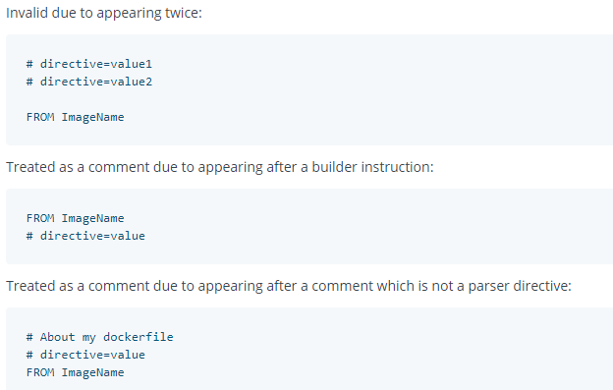
Dockerfile - Parser directives
Format is
# directive=value

Slide 55
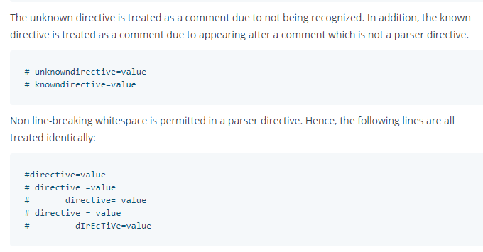
Dockerfile - Parser directives

Slide 56
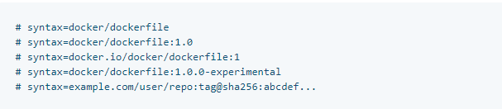
Dockerfile - Parser directives
The escape directive sets the character used to escape characters in a Dockerfile. If not specified, the default escape character is \.
Syntax
escape
The escape directive sets the character used to escape characters in a Dockerfile. If not specified, the default escape character is \.

Slide 57
Dockerfile - Environment Replacement
Environment variables (declared with the ENV statement) can also be used in certain instructions as variables to be interpreted by the Dockerfile. Escapes are also handled for including variable-like syntax into a statement literally.
Environment variables are notated in the Dockerfile either with $variable_name or ${variable_name}

Slide 58
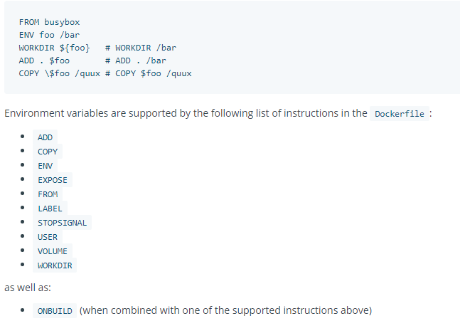
Dockerfile - Environment Replacement

Slide 59
Dockerfile - dockerignore
For Ignoring files or directories
Example :
# comment
*/temp*
*/*/temp*
temp?

Slide 60
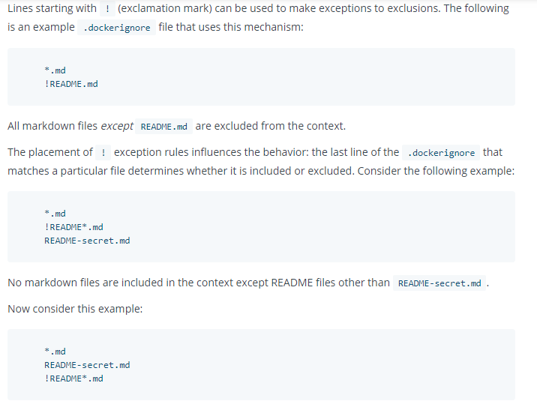
Dockerfile - dockerignore

Slide 61
Dockerfile Commands -FROM
Dockerfile must start with FROM
FROM <image> [AS <name>]
Or
FROM <image>[:<tag>] [AS <name>]
Or
FROM <image>[@<digest>] [AS <name>]
FROM instruction initializes a new build stage and sets the Base Image for subsequent instructions.

Slide 62
Dockerfile - FROM
FROM can appear multiple time
A name can be given to a new build stage by adding AS name to the FROM instruction. The name can be used in subsequent FROM and COPY --from=<name|index> instructions to refer to the image built in this stage.

Slide 63
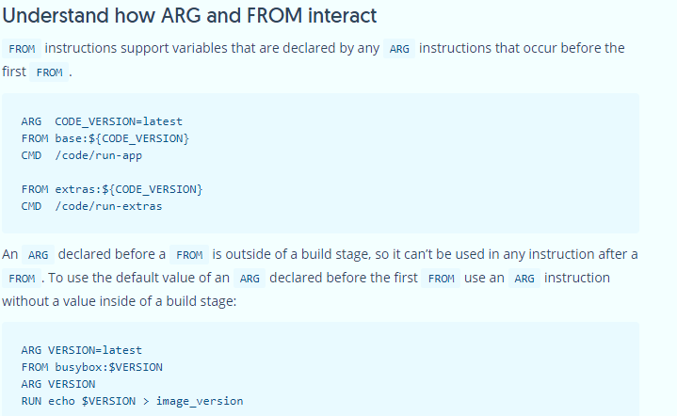
Dockerfile -FROM

Slide 64
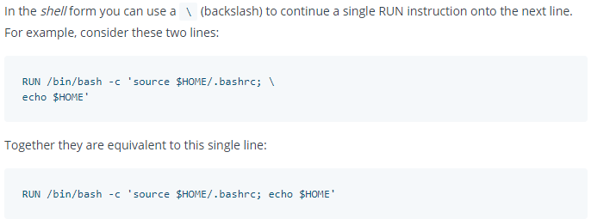
Dockerfile - Run
RUN has 2 forms:
RUN <command> (shell form, the command is run in a shell, which by default is /bin/sh -c on Linux or cmd /S /C on Windows)
RUN ["executable", "param1", "param2"] (exec form)

Slide 65
Dockerfile - CMD
The CMD instruction has three forms:
CMD ["executable","param1","param2"] (exec form, this is the preferred form)
CMD ["param1","param2"] (as default parameters to ENTRYPOINT)
CMD command param1 param2 (shell form)
There can only be one CMD instruction in a Dockerfile. If you list more than one CMD then only the last CMD will take effect.
The main purpose of a CMD is to provide defaults for an executing container. These defaults can include an executable, or they can omit the executable, in which case you must specify an ENTRYPOINT instruction as well.

Slide 66
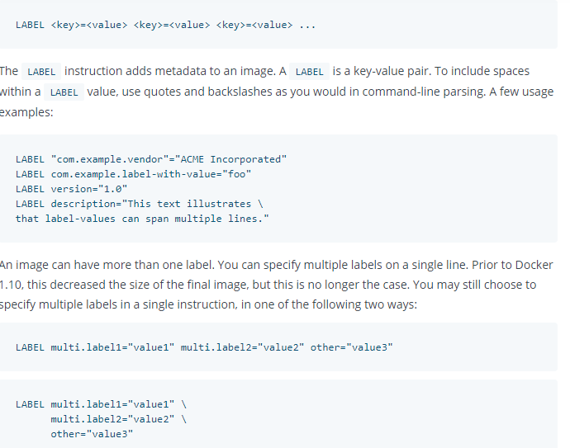
Dockerfile -LABEL

Slide 67
Dockerfile - EXPOSE
EXPOSE <port> [<port>/<protocol>...]
The EXPOSE instruction informs Docker that the container listens on the specified network ports at runtime. You can specify whether the port listens on TCP or UDP, and the default is TCP if the protocol is not specified.
The EXPOSE instruction does not actually publish the port.
Use following in run command to actually execute:
docker run -p 80:80/tcp -p 80:80/udp ...

Slide 68
Dockerfile -ENV
ENV <key> <value>
ENV <key>=<value> ...
The ENV instruction sets the environment variable <key> to the value <value>. This value will be in the environment for all subsequent instructions in the build stage and can be replaced inline in many as well.

Slide 69
Dockerfile - ADD
ADD has two forms:
ADD [--chown=<user>:<group>] <src>... <dest>
ADD [--chown=<user>:<group>] ["<src>",... "<dest>"] (this form is required for paths containing whitespace)
The ADD instruction copies new files, directories or remote file URLs from <src> and adds them to the filesystem of the image at the path <dest>.
Multiple <src> resources may be specified but if they are files or directories, their paths are interpreted as relative to the source of the context of the build.

Slide 70
Dockerfile - COPY
COPY has two forms:
COPY [--chown=<user>:<group>] <src>... <dest>
COPY [--chown=<user>:<group>] ["<src>",... "<dest>"] (this form is required for paths containing whitespace)
Diff wrt ADD
ADD allows <src> to be a URL
If the <src> parameter of ADD is an archive in a recognised compression format, it will be unpacked

Slide 71
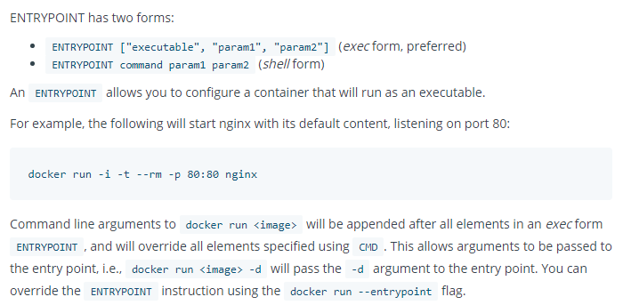
Dockerfile - ENTRYPOINT

Slide 72
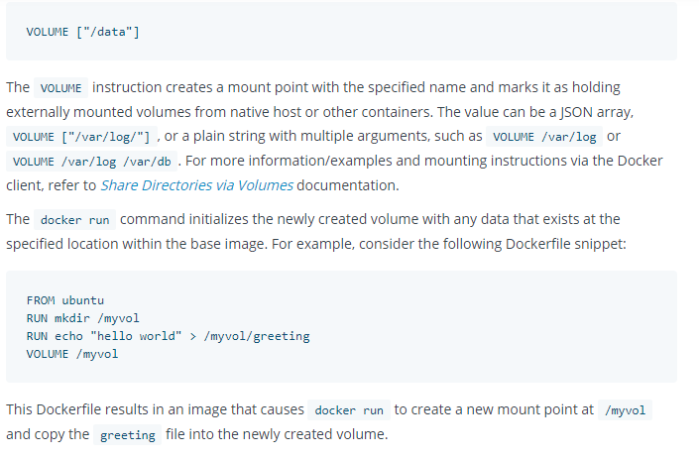
Dockerfile - VOLUMES

Slide 73
Dockerfile - User
USER <user>[:<group>] or
USER <UID>[:<GID>]
The USER instruction sets the user name (or UID) and optionally the user group (or GID) to use when running the image and for any RUN, CMD and ENTRYPOINT instructions that follow it in the Dockerfile.

Slide 74

Dockerfile - WORKDIR

Slide 75
Dockerfile - ARG
ARG <name>[=<default value>]
The ARG instruction defines a variable that users can pass at build-time to the builder with the docker build command using the --build-arg <varname>=<value> flag.

Slide 76

Dockerfile - ARG

Slide 77

Dockerfile – ARG

Slide 78

Dockerfile - ONBUILD

Slide 79

Dockerfile - STOPSIGNAL

Slide 80

Dockerfile - HEALTHCHECK

Slide 81

Dockerfile - Shell

Slide 82

Dockerfile – Best Practices

Slide 83



Dockerfile – Best Practices

Slide 84

Dockerfile – Best Practices

Slide 85

Dockerfile – Best Practices

Slide 86

Dockerfile – Best Practices

Slide 87

Dockerfile – Best Practices
RUN
Split long or complex RUN statements on multiple lines separated with backslashes to make your Dockerfile more readable, understandable, and maintainable.
CMD

Slide 88

Dockerfile Best Practices - EXPOSE

Slide 89

Dockerfile - ENV

Slide 90
Dockerfile & BuildKit
With version 18.09, docker now supports for Buildkit
Detect and skip executing unused build stages
Parallelize building independent build stages
Incrementally transfer only the changed files in your build context between builds
Detect and skip transferring unused files in your build context
Use external Dockerfile implementations with many new features
Avoid side-effects with rest of the API (intermediate images and containers)
Prioritize your build cache for automatic pruning

Slide 91
For any Corporate/Online Training Requirements, you can email me @
milind.technopreneur@gmail.com
Visit my website at
www.technopreneur-milind.com
Subscribe my YouTube Channel
for 6 minutes technical videos

